Slide 1
Docker 101

Slide 2
Introduction to Docker
What is Docker?
Why is it important?

Slide 3
Os-level virtualization

Slide 4
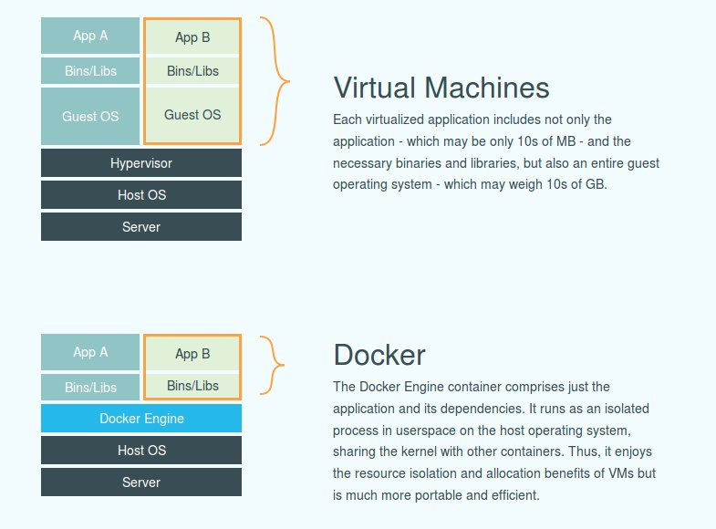

Slide 5
Docker use cases
Continuous deployment
Microservices
Legacy app migration
Multi cloud apps

Slide 6
No more “works on my machine”

Slide 7
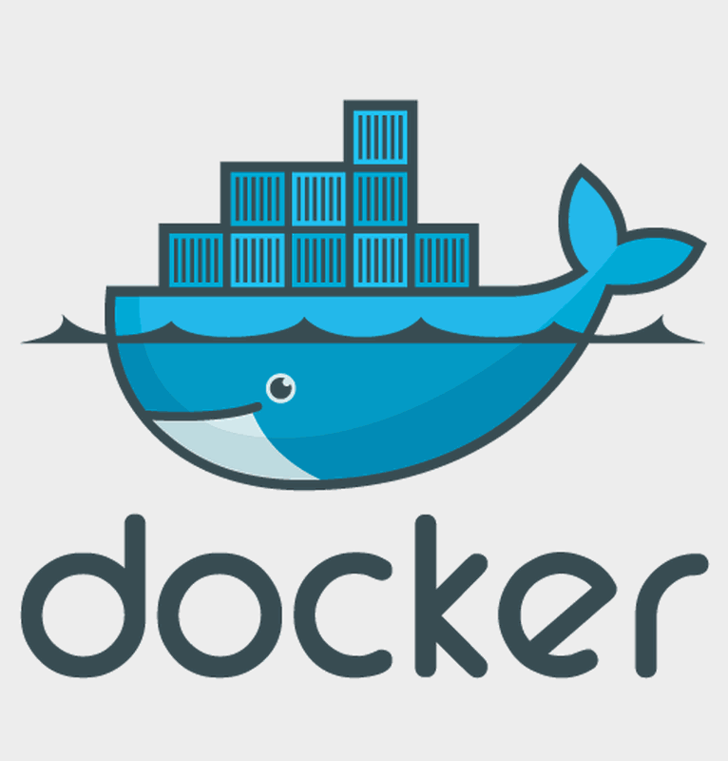
Understanding Docker Components
Docker engine
Docker hub
Trusted registry

Slide 9
Understanding Docker Components
Docker swarm
Docker compose

Slide 10
Benefits of Using Docker
Portability
Low resource usage
Faster deployments

Slide 11
Benefits of Using Docker
Isolation of environment
Quick setup and teardown

Slide 12
Challenges with docker
Managing big amounts of containers becomes complex

Slide 13
One Command Setup
How to set up SQL Server, Redis, RabbitMQ, etc., using Docker
docker pull redis
docker run --name my-redis-instance -d redis

Slide 14
Docker images
Layered structure
Immutable layers
Speed and efficiency
Writable container layer

Slide 15
Getting Started with Docker

Slide 16
Conclusion and Q&A

Slide 17
THANK YOU

